Slide 1
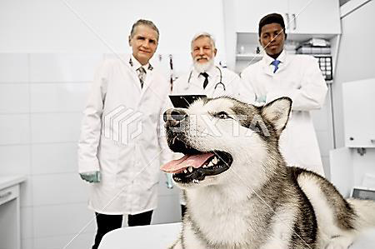
considerations for Anesthesia including: Patient Evaluation and Preparation
Assis. Prof. Dr. Rafid Majeed Naeem

Slide 2
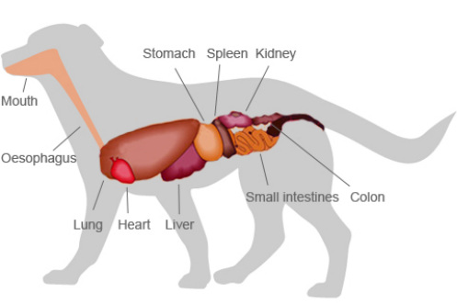
The goal of Preanesthetic Evaluation
The goal is to determine any deviations from the normal that will affect anesthetic uptake, action, elimination, and safety.
Organ systems of greatest concern are
the nervous,
cardiopulmonary,
hepatic, and renal.

Slide 3
Physical status is determined by
(a) history, including an assessment of pain;
(b) inspection (attitude, conformation, temperament, stress, or distress);
(c) palpation, percussion, and auscultation
(d) laboratory determinations and special procedures (e.g., radiographs)

Slide 4
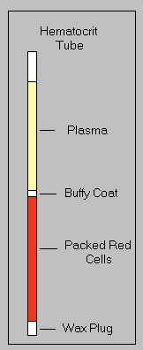
The physical examination and medical history will determine the extent to which laboratory tests and special procedures are necessary. In all but extreme emergencies, packed cell volume and plasma protein concentration should be routinely determined.
سيحدد الفحص البدني والتاريخ الطبي مدى ضرورة إجراء الاختبارات المختبرية والإجراءات الخاصة. في جميع حالات الطوارئ باستثناء الحالات القصوى، ينبغي تحديد حجم الخلايا المضغوطة وتركيز بروتين البلازما بشكل روتيني.

Slide 5
Depending on the medical history and physical examination, additional evaluations may include
اعتمادًا على التاريخ الطبي والفحص البدني، قد تشمل التقييمات الإضافية
a. complete blood counts; تعداد الدم الكامل.
b. urinalysis; تحليل البول.
c. blood chemistries to identify the status of kidney and liver function, blood gases, and pH;
كيمياء الدم لتحديد حالة وظائف الكلى والكبد، وغازات الدم، ودرجة الحموضة.
d. electrocardiography; تخطيط القلب؛
e. clotting time and platelet counts; وقت التخثر وعدد الصفائح الدموية.
f. fecal examinations; فحوصات البراز؛
g. blood electrolyte determinations تحديد نسبة الكهارل في الدم
Notice: Tests should not be run unless it is suspected their results could cause a change in anesthetic management.
h. Radiographic and/or fluoroscopic examination may also be indicated, especially in animals that are susceptible to chronic respiratory infections

Slide 6
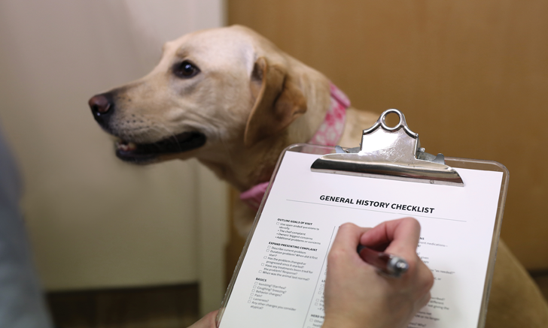
The history should include
a. previous and current health;
b. presenting complaint, its severity, and its duration;
c. concurrent symptoms of disease (e.g., diarrhea, vomiting, exercise intolerance, ascites)
d. pregnancy;
e. exposure to drugs;
f. prior anesthetic history
g. Recent feeding

Slide 7
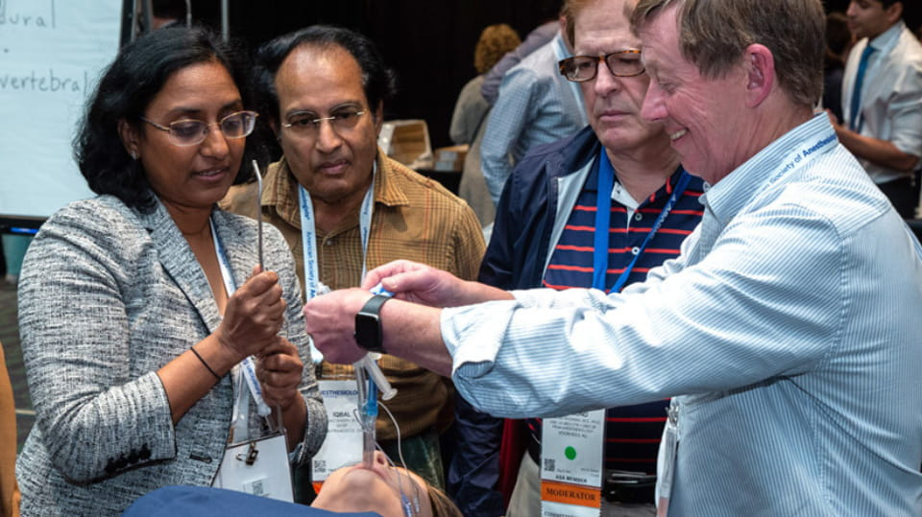
Following examination, the physical status of the patient should be classified as to its general state of health according to the American Society of Anesthesiologists (ASA) classification and the information recorded
بعد الفحص، يجب تصنيف الحالة الجسدية للمريض من حيث حالته الصحية العامة وفقًا لتصنيف الجمعية الأمريكية لأطباء التخدير (ASA) والمعلومات المسجلة

Slide 9
.The preliminary physical examination should be done in the owner's presence, if possible, so that a prognosis can be given personally. This allows the client to ask questions and enables the veterinarian to communicate the risks of anesthesia and allay any fears regarding management of the patient.
ينبغي إجراء الفحص البدني الأولي بحضور المالك، إن أمكن، حتى يمكن تقديم التشخيص شخصيًا. يتيح ذلك للعميل طرح الأسئلة ويمكّن الطبيب البيطري من إيصال مخاطر التخدير وتهدئة أي مخاوف بشأن عناية المريض.

Slide 10
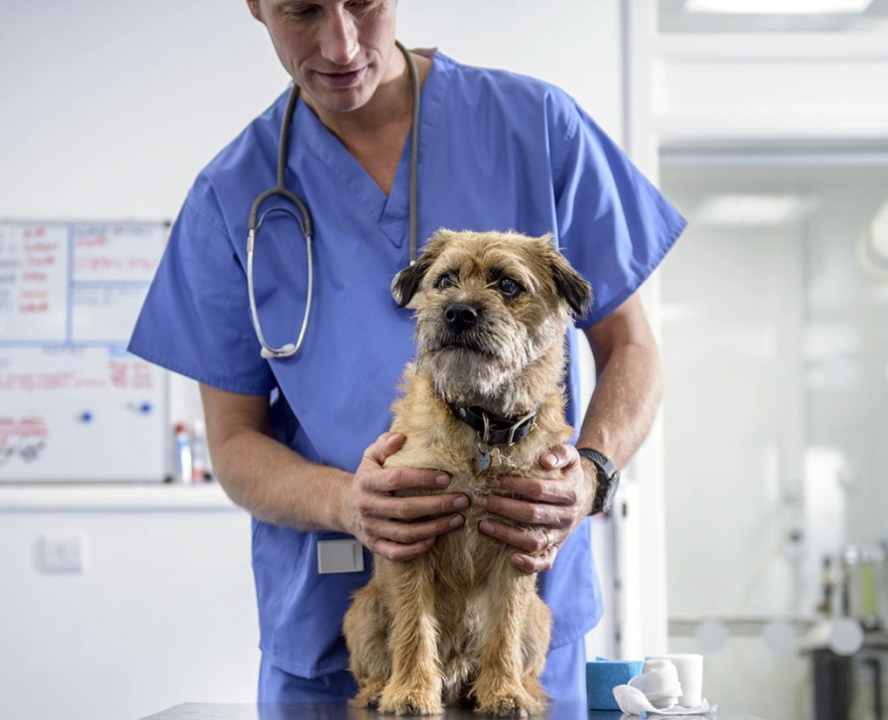
Patient Preparation
Too often, operations are undertaken with inadequate preparation of patients. With most types of general anesthesia, it is best to have patients off feed for 12 h previously.

Slide 11
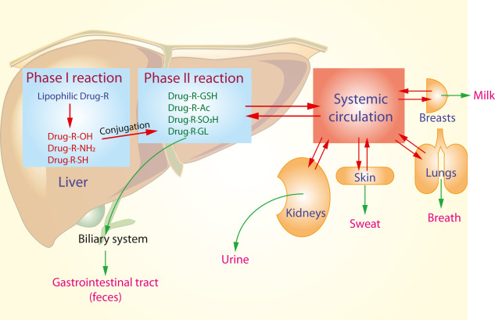
adverse effect by fasting (some time)
Some species are adversely affected by fasting. Birds, neonates, and small mammals may become hypoglycemic within a few hours of starvation, and mobilization of glycogen stores may alter rates of drug metabolism and clearance.

Slide 12
Induction of anesthesia in animals having a full stomach should be avoided, if at all possible, because of the hazards of aspiration.
Distension of the rumen in sheep and larger ruminants has been shown to impair ventilation, with consequent hypoxemia and hypercapnia.
أن انتفاخ الكرش في الأغنام والمجترات الكبيرة يضعف التهوية، مما يؤدي إلى نقص الأكسجة في الدم وفرط ثنائي أكسيد الكربون في الدم.
In horses, a full stomach may rupture during induction and casting. Although limitation of food does not empty the rumen, the possibility of regurgitation is perhaps reduced if water is withheld for 12 to 24 h prior to induction.

Slide 13
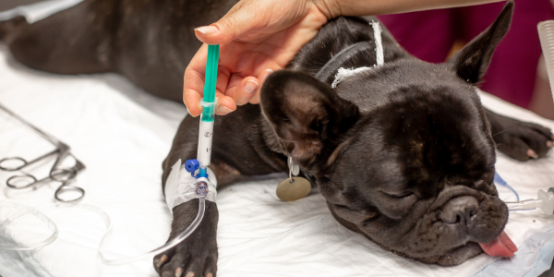
In most species, especially in the young and aged, water is usually offered up to the time that preanesthetic agents are administered. It should be remembered that many older animals suffer from renal disease.
In any case, it is good anesthetic practice to administer intravenous fluids during anesthesia to help
maintain adequate blood pressure and urine production,
to provide an available route for drug administration.

Slide 14
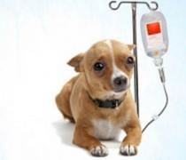
Dehydrated animals should be treated with fluids and appropriate alimentation prior to operation; fluid therapy should be continued as required. The delay occasioned by administration of fluids is more than compensated for by the animal's increased ability to withstand the stress of anesthesia and surgical trespass.
يجب معالجة الحيوانات المجففة بالسوائل والتغذية المناسبة قبل العملية؛ يجب أن يستمر العلاج بالسوائل كما هو مطلوب. يتم تعويض التأخير الناتج عن إعطاء السوائل من خلال زيادة قدرة الحيوان على تحمل ضغوط التخدير والتعدي الجراحي.

Slide 15
Systemic administration of antibiotics preoperatively is a helpful prophylactic measure prior to major surgery or if contamination of the operative site is anticipated and antibiotics ideally are given I or 2 h before anesthetic induction begins.
Animals having such infections should receive specific therapy prior to anesthesia, and, local or regional anesthesia should be strongly considered.
Anemia and hypovolemia, as determined clinically and hematologically, should be corrected by administration of whole blood or blood components and balanced electrolyte solutions.

Slide 16
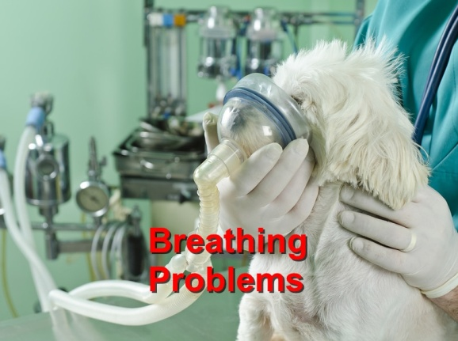
Several conditions may severely restrict effective ventilation. These include:
هناك عدة حالات قد تقيد بشدة التهوية الفعالة. وتشمل هذه
a. upper-airway obstruction by masses or abscesses,
b. pneumothorax,
c. hemothorax,
d. pyothorax,
e. diaphragmatic hernia
f. gastric or rumen distention.
Oxygen administration by nasal catheter or mask is indicated if the patient will accept it. A tracheotomy may be performed under local anesthesia prior to induction.
Intrapleural air or fluid should be removed by aspiration prior to induction, because the effective lung volume may be greatly reduced and severe respiratory embarrassment may occur on induction.
Although no attempt should be made to insert an endotracheal catheter in these patients prior to anesthesia, this must be done immediately after induction

Slide 17
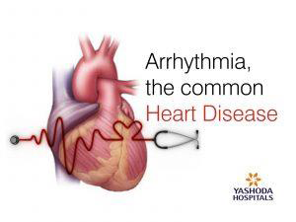
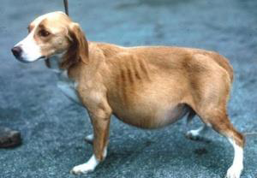
Heart disease is a contraindication for general anesthesia. If animals must be anesthetized, an attempt at compensation through appropriate antiarrhythmic drugs, and diuresis should be made prior to anesthesia.
If ascites is present, this fluid should be aspirated to reduce excessive pressure on the diaphragm.

Slide 18
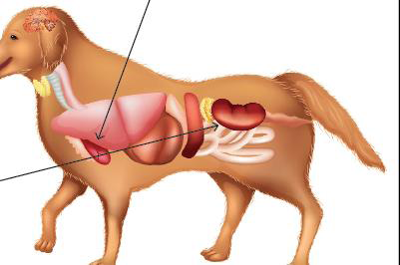
In cases of hepatic or renal insufficiency-for instance, in many bacterial and viral infections of mice, dogs, or in parasitism of calves, sheep, and rabbits-the mode of anesthetic elimination should receive strong consideration, with inhalation anesthesia preferred.
يجب أن يحظى أسلوب التخلص من المخدر باهتمام شديد، مع تفضيل التخدير عن طريق الاستنشاق

Slide 19
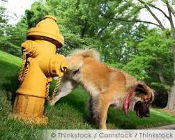
Just prior to induction, it is desirable to encourage defecation and/or urination by giving animals access to a run or exercise pen. If this attempt is unsuccessful, catheterization or bladder compression may be necessary prior to surgery. Once an animal is anesthetized, the bladder can be emptied by slow, steady compression through the abdominal wall or by catheterization. An empty bladder is an advantage in abdominal surgery because urine may contaminate the operative field.

Slide 20
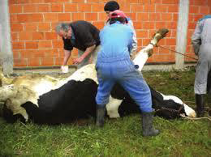
During anesthesia, patients should, if possible, be restrained in a normal physiological position. Compression of the chest, acute angulation of the neck, overextension or compression of limbs, and compression of the posterior vena cava by large viscera can all lead to serious compromise.

Slide 21
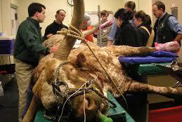
In all species, the head should be extended to provide a free airway and to prevent kinking of the endotracheal tube.
في جميع الأنواع، يجب تمديد الرأس لتوفير مجرى هوائي حر ولمنع التواء الأنبوب الرغامي.

Slide 22
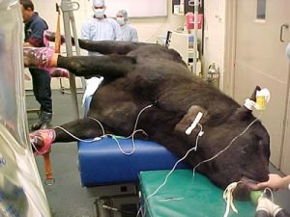
In ruminants, it is desirable to have the head tilted down to enable drainage of saliva. Downward tilting of the hindquarters and abdomen (below the thorax), with minimal compression of the abdomen, limits reflux of rumen contents.
في الحيوانات المجترة، من المستحسن أن يكون الرأس مائلاً إلى الأسفل لتمكين تصريف اللعاب. إن إمالة المؤخرة والبطن إلى الأسفل (تحت الصدر)، مع الحد الأدنى من الضغط على البطن، يحد من ارتجاع محتويات الكرش.

Slide 23
On induction, if active regurgitation begins with large volumes of ruminal contents flowing into the pharyngeal cavity, pressure should be applied immediately by externally grasping the esophagus dorsal to the trachea to prevent further flow.
Alternatively, an endotracheal tube can be inserted into the esophagus and the cuff rapidly inflated, directing the flow through the tube away from the laryngeal opening while an endotracheal tube is properly placed to protect the airway from contamination.
وبدلاً من ذلك، يمكن إدخال أنبوب القصبة الهوائية في المريء ويتم نفخ الكفة بسرعة، وتوجيه التدفق عبر الأنبوب بعيدًا عن فتحة الحنجرة بينما يتم وضع الأنبوب الرغامي بشكل صحيح لحماية مجرى الهواء من التلوث.

Slide 24
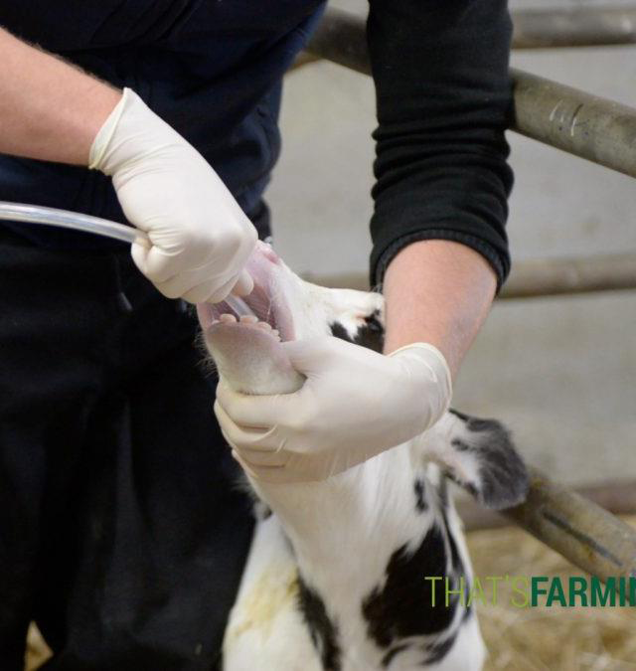
Precautions should also be taken to prevent accumulation of rumen gases during anesthesia. This may be done by passage of a large-bore stomach tube.

Slide 25
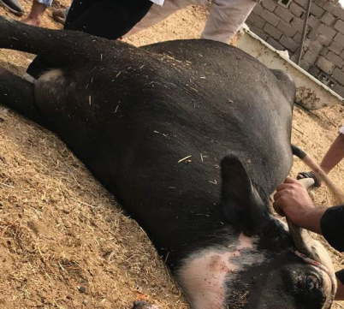
During emergence from anesthesia, it is desirable to position ruminants in sternal recumbency.
In all instances, thorough padding beneath the animal is mandatory.
أثناء الخروج من التخدير، من المستحسن وضع الحيوانات المجترة في وضع الاستلقاء القصي.
في جميع الحالات، الوسادة أسفل الحيوان إلزامية

Slide 26
شكرا

